Slide 1
Modules

Slide 2

Until now we learned about different ways of reusing code.
Loops - the same code will be executed several times
Functions - we can define some procedure and reuse them as we want
Modules – (re)use libraries defined by other people
Modules

Slide 3
Modules are actually .py files, containing python code. A module can define classes, functions and variables.
Modules can be imported and used
import my_first_module
After importing a module, we can use the functions and variables that the modules contain.
Let us implement out module that calculates areas of different shapes
Import always on the top of the file!!!!
Modules

Slide 4
area_module.py
const_pi = 3.14
def calc_area_circle(radius):
return radius**2*const_pi
def calc_area_square(edge):
return edge*edge
def calc_area_rectangle(edgeHor, edgeVer)
return edgeHor, edgeVer
Modules

Slide 5
import area_module
import area_module as am
from area_module import calc_area_circle
from area_module import *
Regular import
Introduce an alias as a name
Import just calc_area_circle function
Import all functions
Modules

Slide 6
Actually, you used modules in your homework already ;)
Can you remember them?
import random
import math
import datetime
To see more about these modules, have a look at:
https://python-textbok.readthedocs.io/en/1.0/Useful_Libraries.html
Modules

Slide 7
And modules can be super fun. Try this out!
Can you remember them?
import emojis
emojified = emojis.encode("I am :snake: programmer!")
print(emojified)
Have a look here for more inspiration
https://www.webfx.com/tools/emoji-cheat-sheet/
Modules

Slide 8
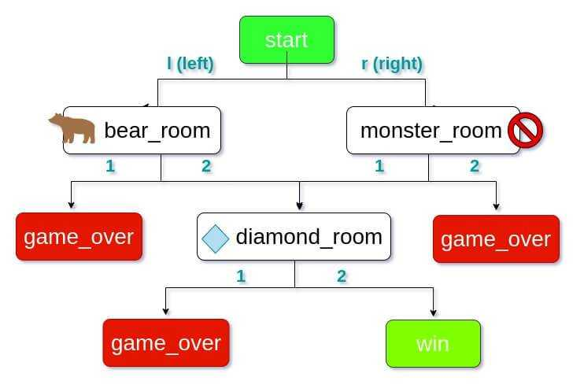
def game_over(message = 'Sorry! Game Over!'):
print (message)
def win(message = 'Congrat chaps! You win!'):
print (message)
def start():
print ('The game started. Yhave 2 doors')
choice = input("choose r or l: ")
if (choice == 'l'):
bear_room()
elif (choice == 'r'):
monster_room()
else:
print("Hey, you have to write r or l")
def monster_room() :
print('you just enter monster room. You have 2 doors')
choice = input('please select an option')
if (choice == '1'):
diamond_room()
elif (choice == '2'):
game_over()
else:
print ('enter door 1 or 2')
def bear_room():
print('Welcome to the Bear Room. Now you have 2 choices.')
a=int(input('Would you like to enter Room 1 or 2?'))
if a == 1:
game_over()
elif a == 2:
diamond_room()
else :
print('You choose an invalid option')
def diamond_room():
print ("Yahoo, you have entetred the diamond room- You have 2 doors")
choice = input()
if (choice == '1'):
game_over()
elif (choice == '2'):
win()

